Slide 1
Workshop: CS1301 Online – A fresh Freshman Experience
David Joyner
March 3rd, 2018
Augusta State University

Slide 2
CS1301 Online – A fresh Freshman Experience
Introduction to Computer Science
CS1301
Introduction to
Computing
CS1315
Introduction to Media Computation
CS1371
Computing for
Engineers
2016 Enrollment: 810
Taken by:
College of Computing
College of Sciences
Industrial Systems and Engineering
…and anyone else
2016 Enrollment: 426
Taken by:
College of Design
College of Business
Ivan Allen College of Liberal Arts
…and anyone else
2016 Enrollment: 2103
Taken by:
College of Engineering (except ISyE)
…and anyone else

Slide 3
CS1301 Online – A fresh Freshman Experience
Accreditation
Personalization
Adaptivity
CS1301
Introduction to
Computing
CS1301
Introduction to
Computing Online
Feedback
Assessment
Modularity
Congruency
Interactivity

Slide 4
CS1301 Online – A fresh Freshman Experience
Course Videos
Integrated Exercises
Adaptive Textbook
CS1301
Introduction to
Computing
CS1301
Introduction to
Computing Online
Problem Sets
Programming Homework
Proctored Exams
Recitations & TAs

Slide 5
CS1301 Online – A fresh Freshman Experience
~500 2-minute videos
Course Videos
~1000 integrated exercises (one per video minute)
Integrated Exercises
~1000 integrated questions with feedback (50 per chapter)
Adaptive Textbook
Equipped with live, personalized feedback
Problem Sets
Equipped with live, personalized feedback
Programming Homework
Proctored exams occurring within a browser-based IDE
Proctored Exams
Traditional in-person recitations, graders, and teaching assistants
Recitations & TAs

Slide 6
CS1301 Online – A fresh Freshman Experience
Course Videos
Four offerings:
Free MOOC
Integrated Exercises
Adaptive Textbook
Verified MOOC
Problem Sets
Certification MOOC
Programming Homework
Georgia Tech Course
Proctored Exams
Recitations & TAs

Slide 7
CS1301 Online – A fresh Freshman Experience
Four offerings:
Free MOOC
Opened February 2017, Free
Verified MOOC
Opened February 2017, $100
Certification MOOC
Opening May 2018, $300
Georgia Tech Course
Since Spring 2017, Tuition
Free Course Available at bit.ly/CS1301x

Slide 8





CS1301 Online – A fresh Freshman Experience
Course Content
Video Course Platform
Adaptive Textbook Platform
Partnerships
Proctoring Platform
Assignment Platform

Slide 9
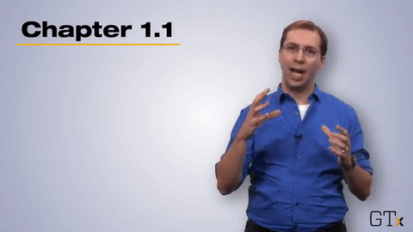
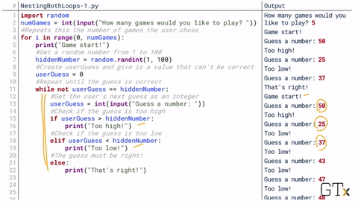
CS1301 Online – A fresh Freshman Experience
Course Preview
20% Headshot
80% Screencapture
All Course Content Available at bit.ly/CS1301x

Slide 10
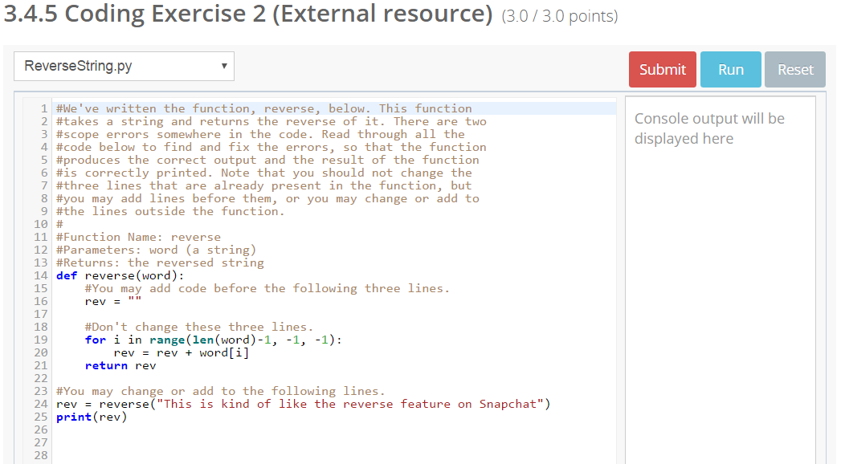
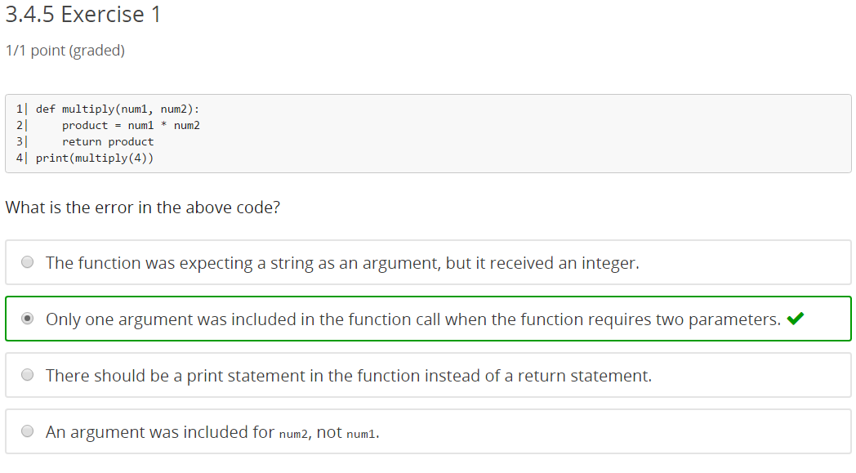
CS1301 Online – A fresh Freshman Experience
Course Preview
300 Coding Problems
500 Exercises
All Course Content Available at bit.ly/CS1301x

Slide 11
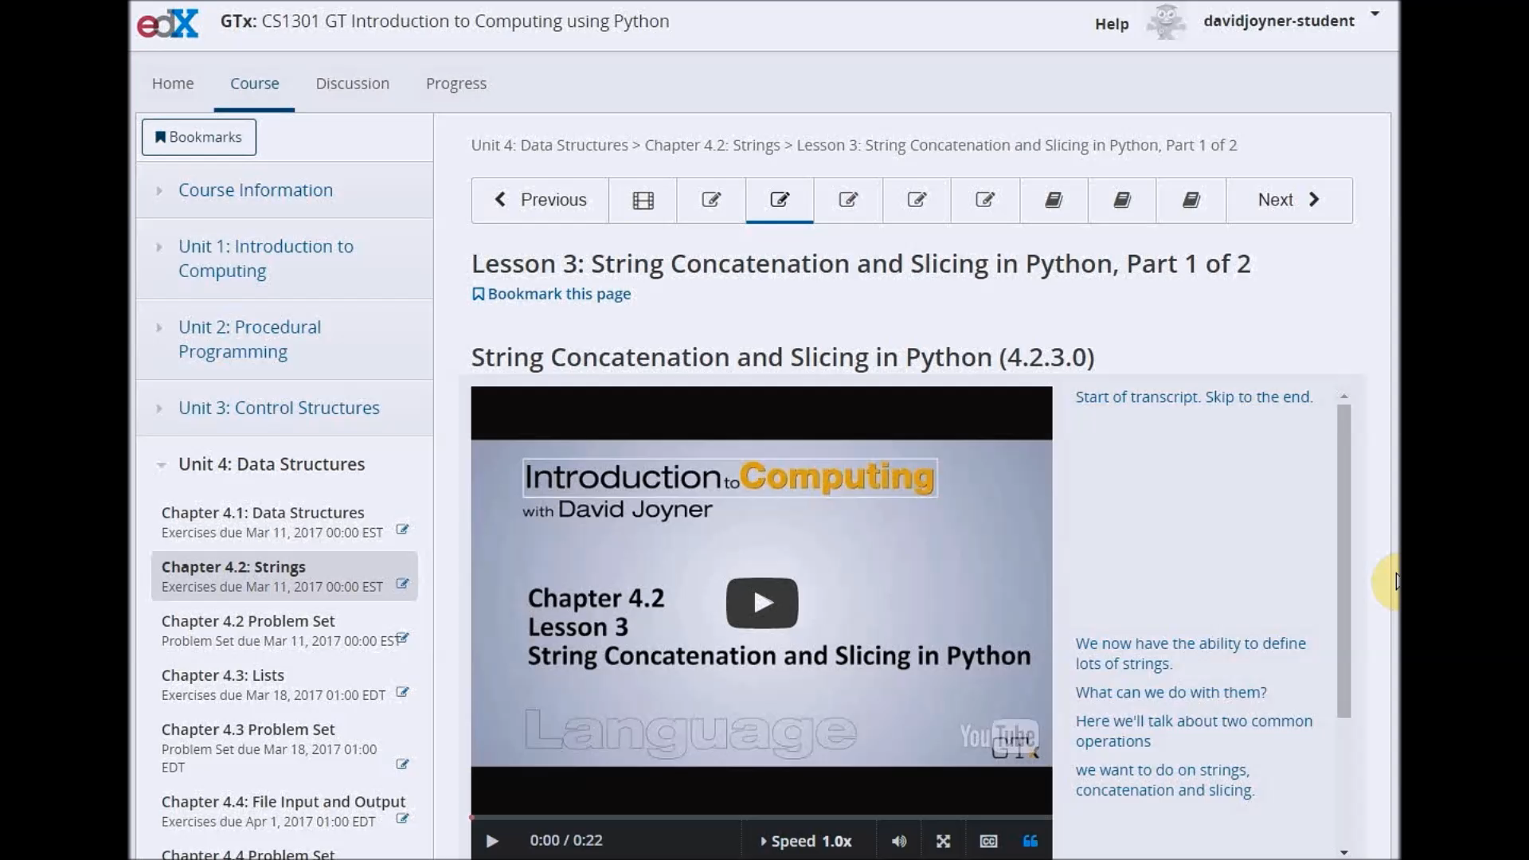
CS1301 Online – A fresh Freshman Experience
Course Preview
Asynchronous lectures
Dynamic transcripts
Interspersed exercises
Iterative exercises
Flexible feedback
Identical exam interface
Live exam feedback
Questions answered via forums and Slack
Deadlines & recitations for Tech students

Slide 12
CS1301 Online – A fresh Freshman Experience
Demographic Differences
 | Online students are…
Gender | Roughly the same
Age | Notably older
Race/Ethnicity | Notably more African-American
Target Industry | Notably less engineering-focused
Expected Workload | Expecting less work per week
Employment | Notably more employed

Slide 13
CS1301 Online – A fresh Freshman Experience
Learning Outcomes
No statistically-significant differences in pre-test scores, post-test scores, or change in test score.

Slide 14
CS1301 Online – A fresh Freshman Experience
Student Experience Results
94%
CS1301 Online is at least as good as other college courses.
81%
CS1301 Online is better than other college courses.

Slide 15
CS1301 Online – A fresh Freshman Experience
MOOC Enrollment Results
Current Enrollment | 70,836
Verified (Paid) Enrollment | 515
Active Learners | 1,419
Prior Education | 28% High School or Less; 27% Advanced Degree
Gender | 21.8% Female
Countries Represented | 196 (28% US, 14% India)

Slide 16
CS1301 Online – A fresh Freshman Experience
Questions?
For more:
omscs.gatech.edu
www.DavidJoyner.net
LucyLabs.gatech.edu
Contact me:
david.joyner@gatech.edu

